Slide 1
Celebrate Creationtide: 1st September – 4th October Scripture texts for Daily Prayer, Reflection & Action

Slide 2
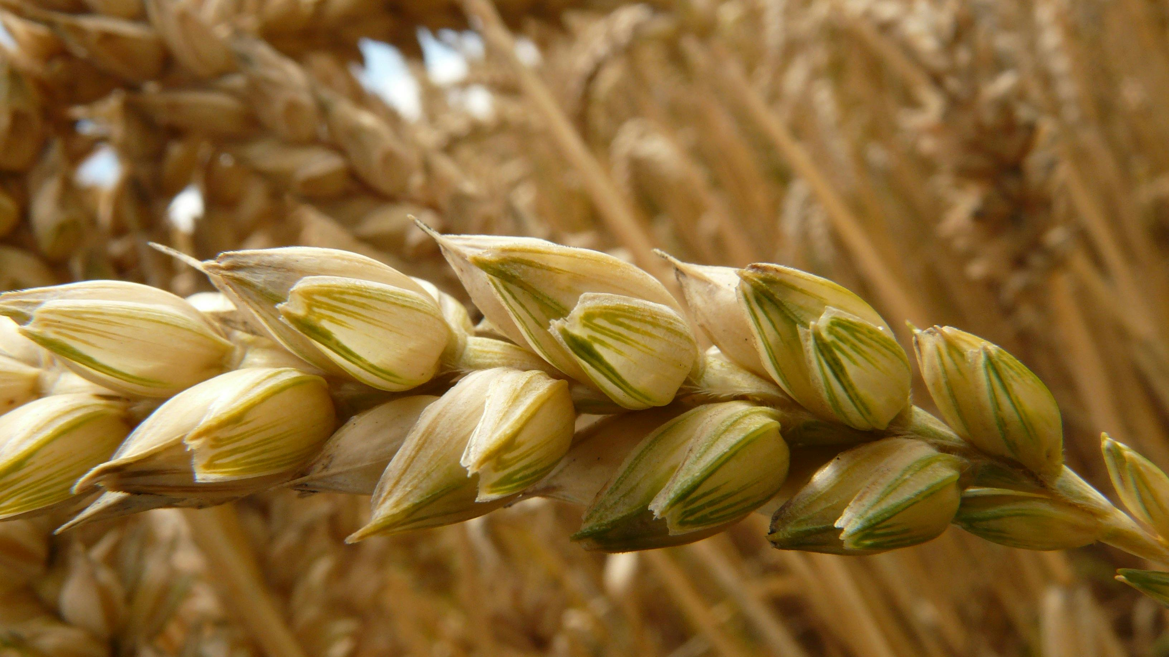
Deuteronomy 11:12
A land that the Lord your God cares for. The eyes of the Lord
your God are always upon it, from the beginning of the year to the end of the year.

Slide 3
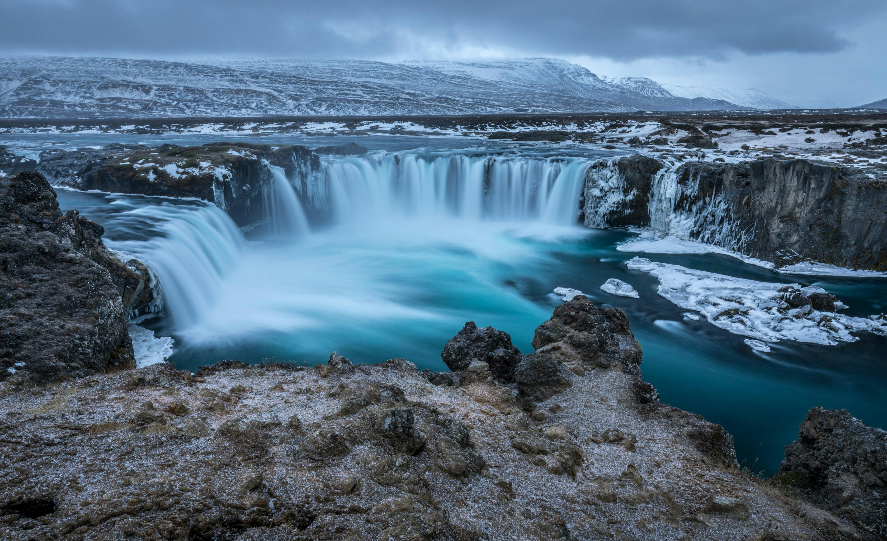
Ezekiel 33:28
And I will make the land a desolation and a waste, and her proud might shall come to an end...

Slide 4
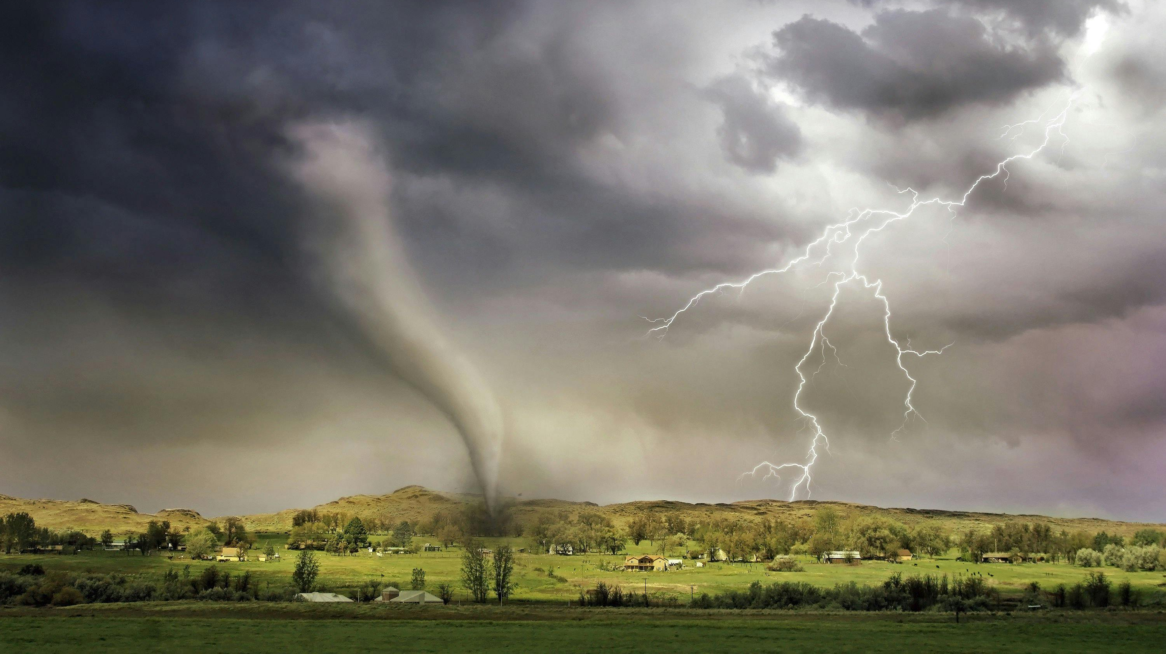
Romans 8:19b-21
For the creation was subjected to futility, not willingly, but because of him who subjected it, in hope that the creation itself will be set free from its bondage to corruption and obtain the freedom of the glory of the children of God.

Slide 5
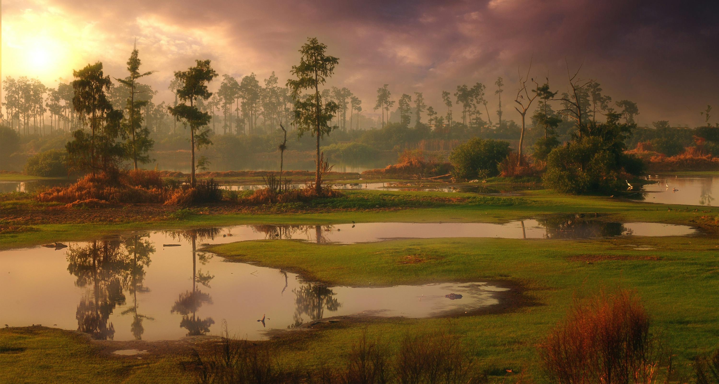
Ezekiel 34:18 Is it not enough for you to feed on the good pasture, that you must tread down with your feet the rest of your pasture; and to drink of clear water, that you must muddy the rest of the water with your feet?

Slide 6
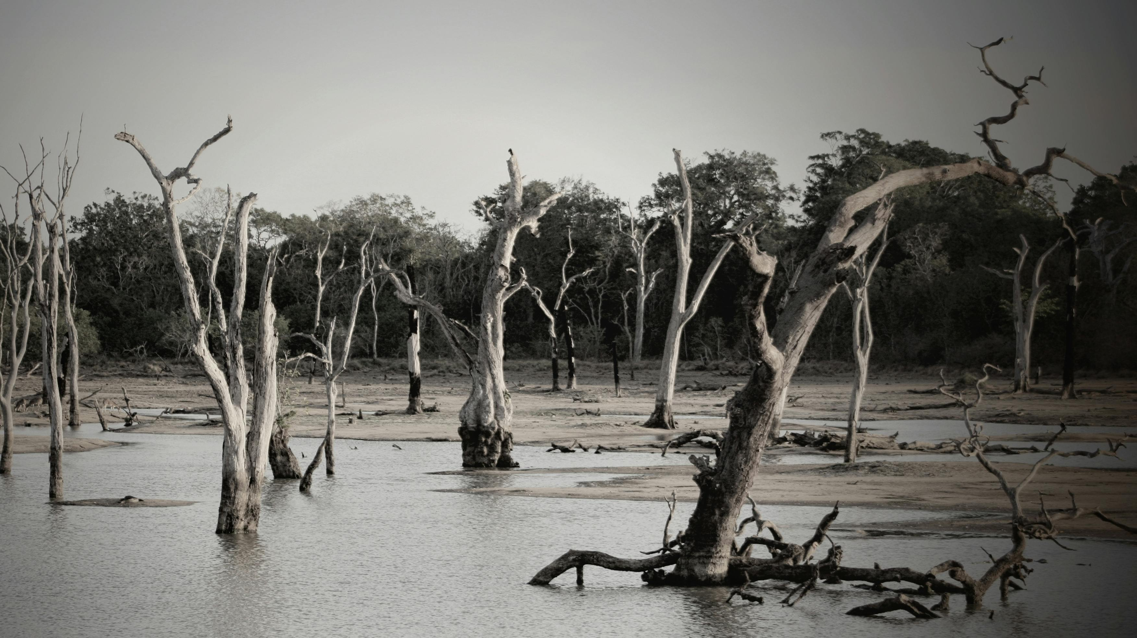
Jeremiah 12:4
How long will the land mourn and the grass of every field wither?

Slide 7
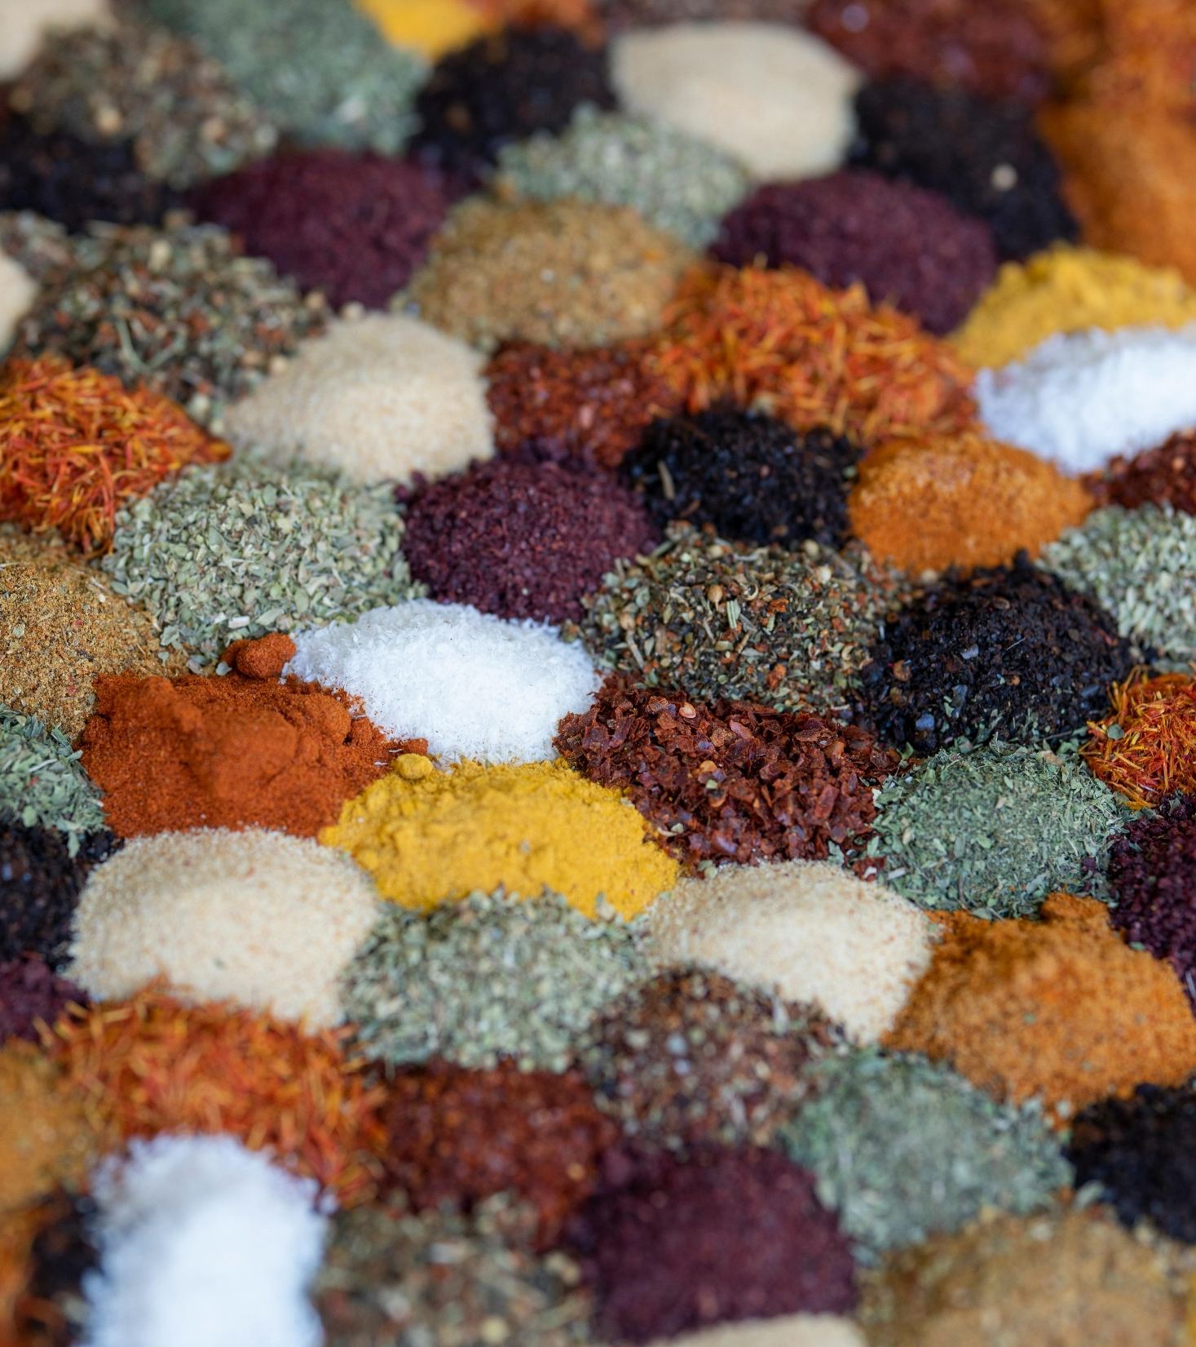
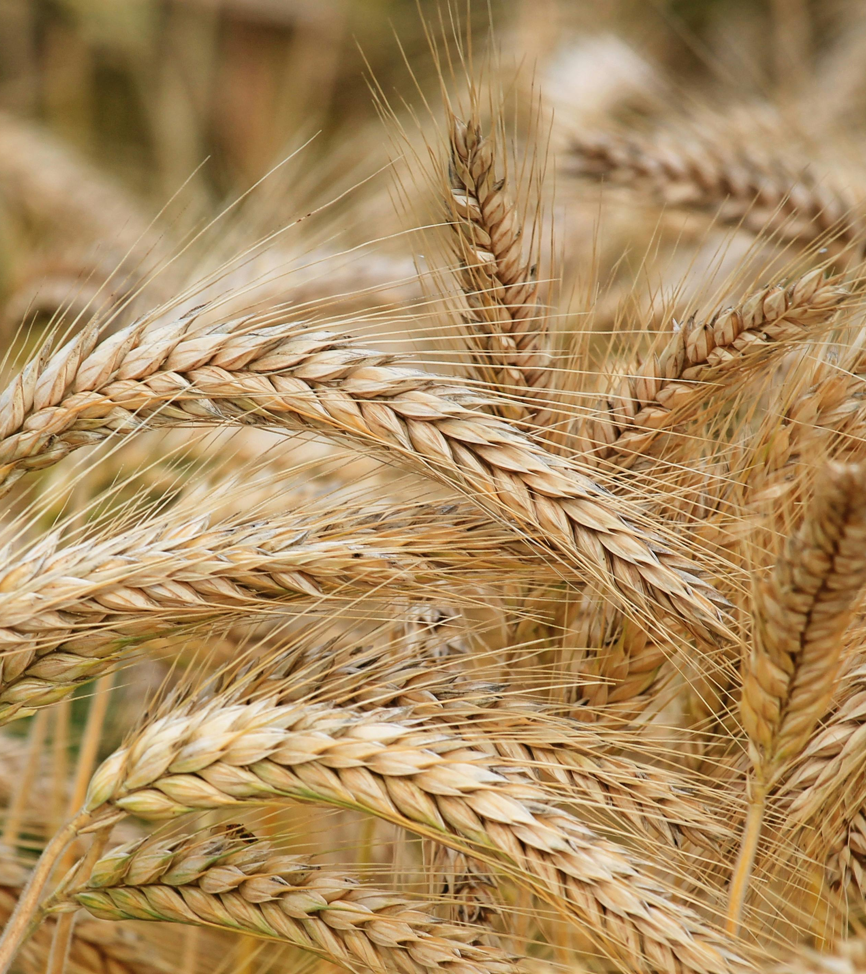
Leviticus 25:23-24
“The land shall not be sold in perpetuity, for the land is mine. For you are strangers and sojourners with me. And in all the country you possess, you shall allow a redemption of the land.

Slide 8
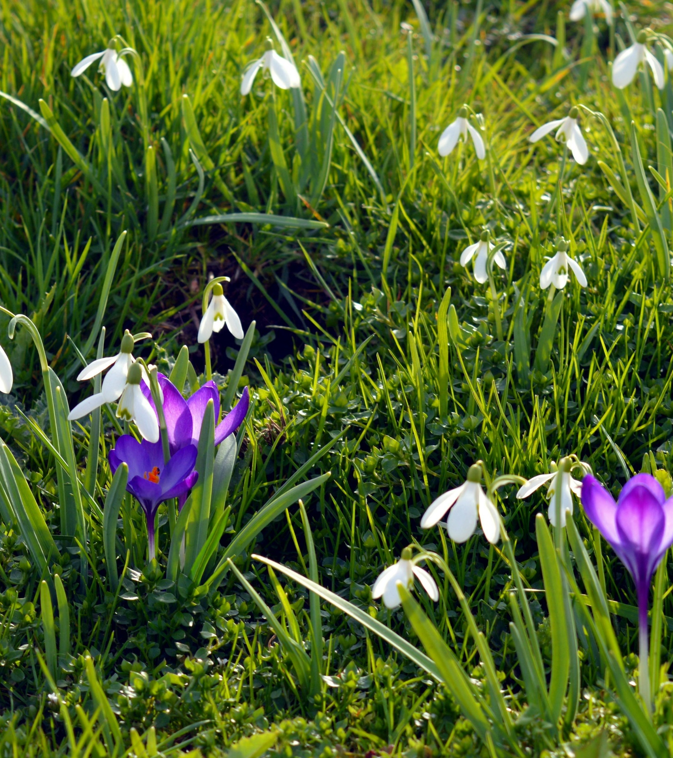
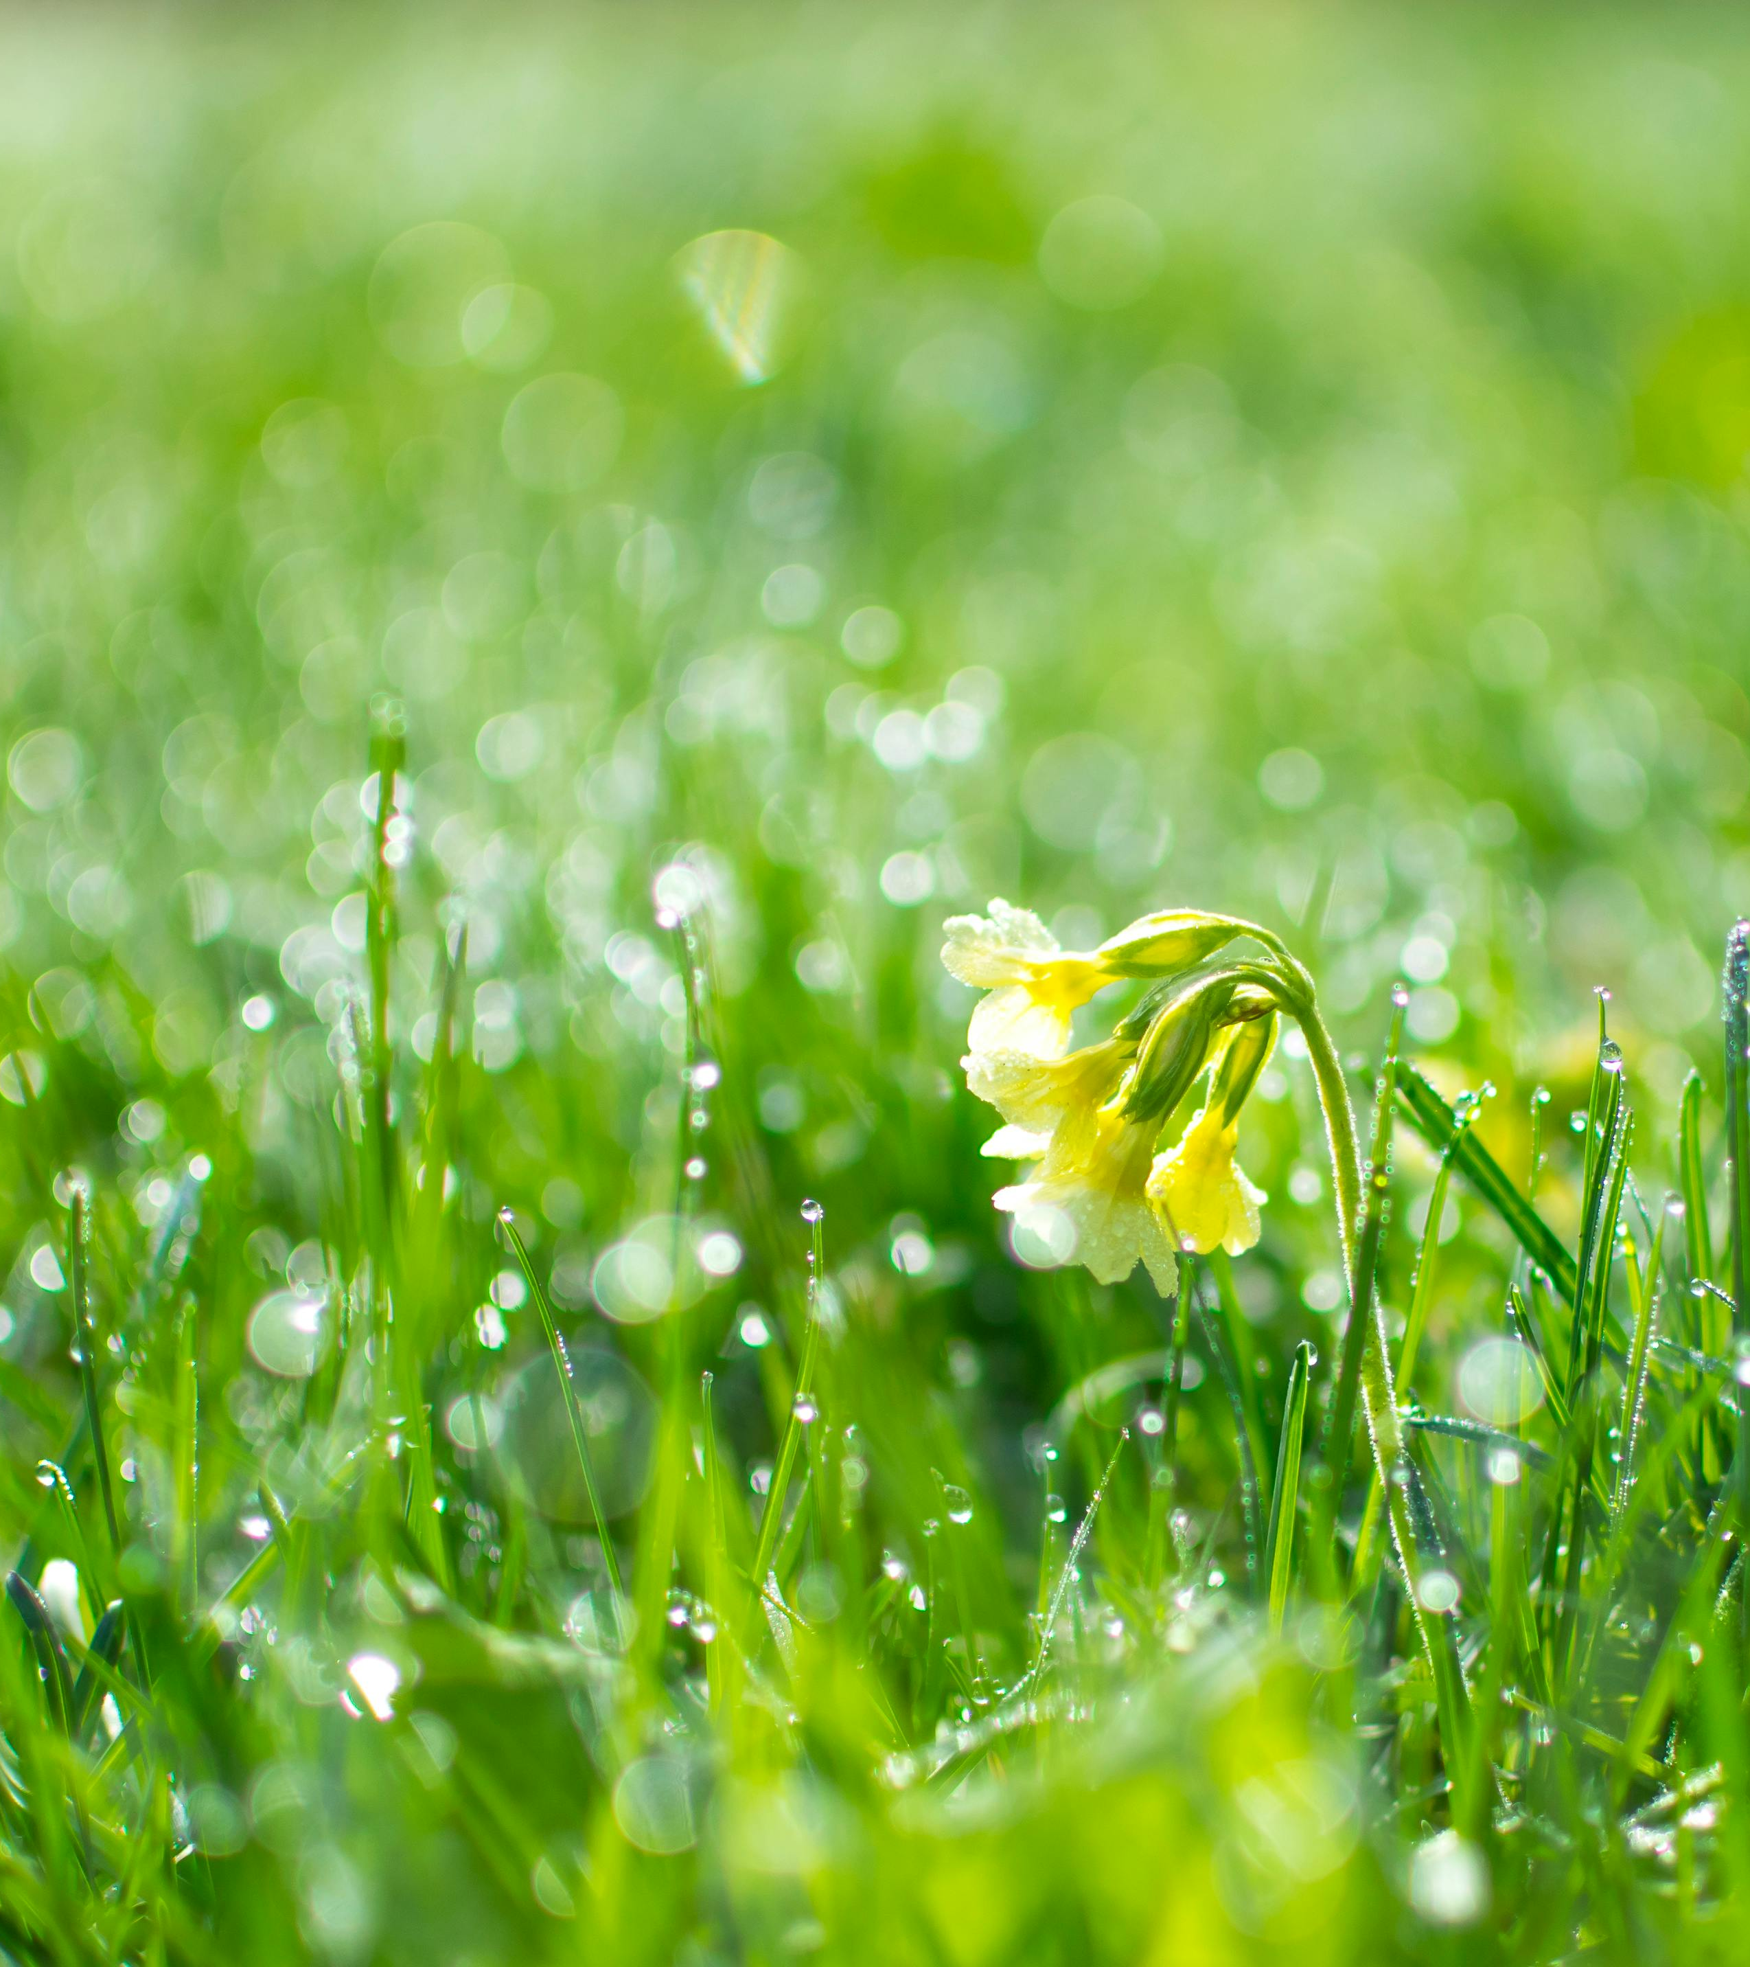
Isaiah 35:1
The wilderness and the dry land shall be glad; the desert shall rejoice and blossom like the crocus; it shall blossom abundantly and rejoice with joy and singing..

Slide 9
Pray, Reflect and Act this Creationtide.

