Slide 1
Celebrate Creationtide: 1st September – 4th October Scripture texts for Daily Prayer, Reflection & Action

Slide 2
Numbers 35:33-34
You shall not pollute the land in which you live, …. You shall not defile the land in which you live, in the midst of which I dwell, for I the Lord dwell in the midst of the people of Israel.”

Slide 3
Proverbs 19:17
Whoever is generous to the poor lends to the Lord, and he will repay him for his deed.

Slide 4
Isaiah 5:8
Woe to those who join house to house, who add field to field, until there is no more room, and you are made to dwell alone in the midst of the land.”

Slide 5
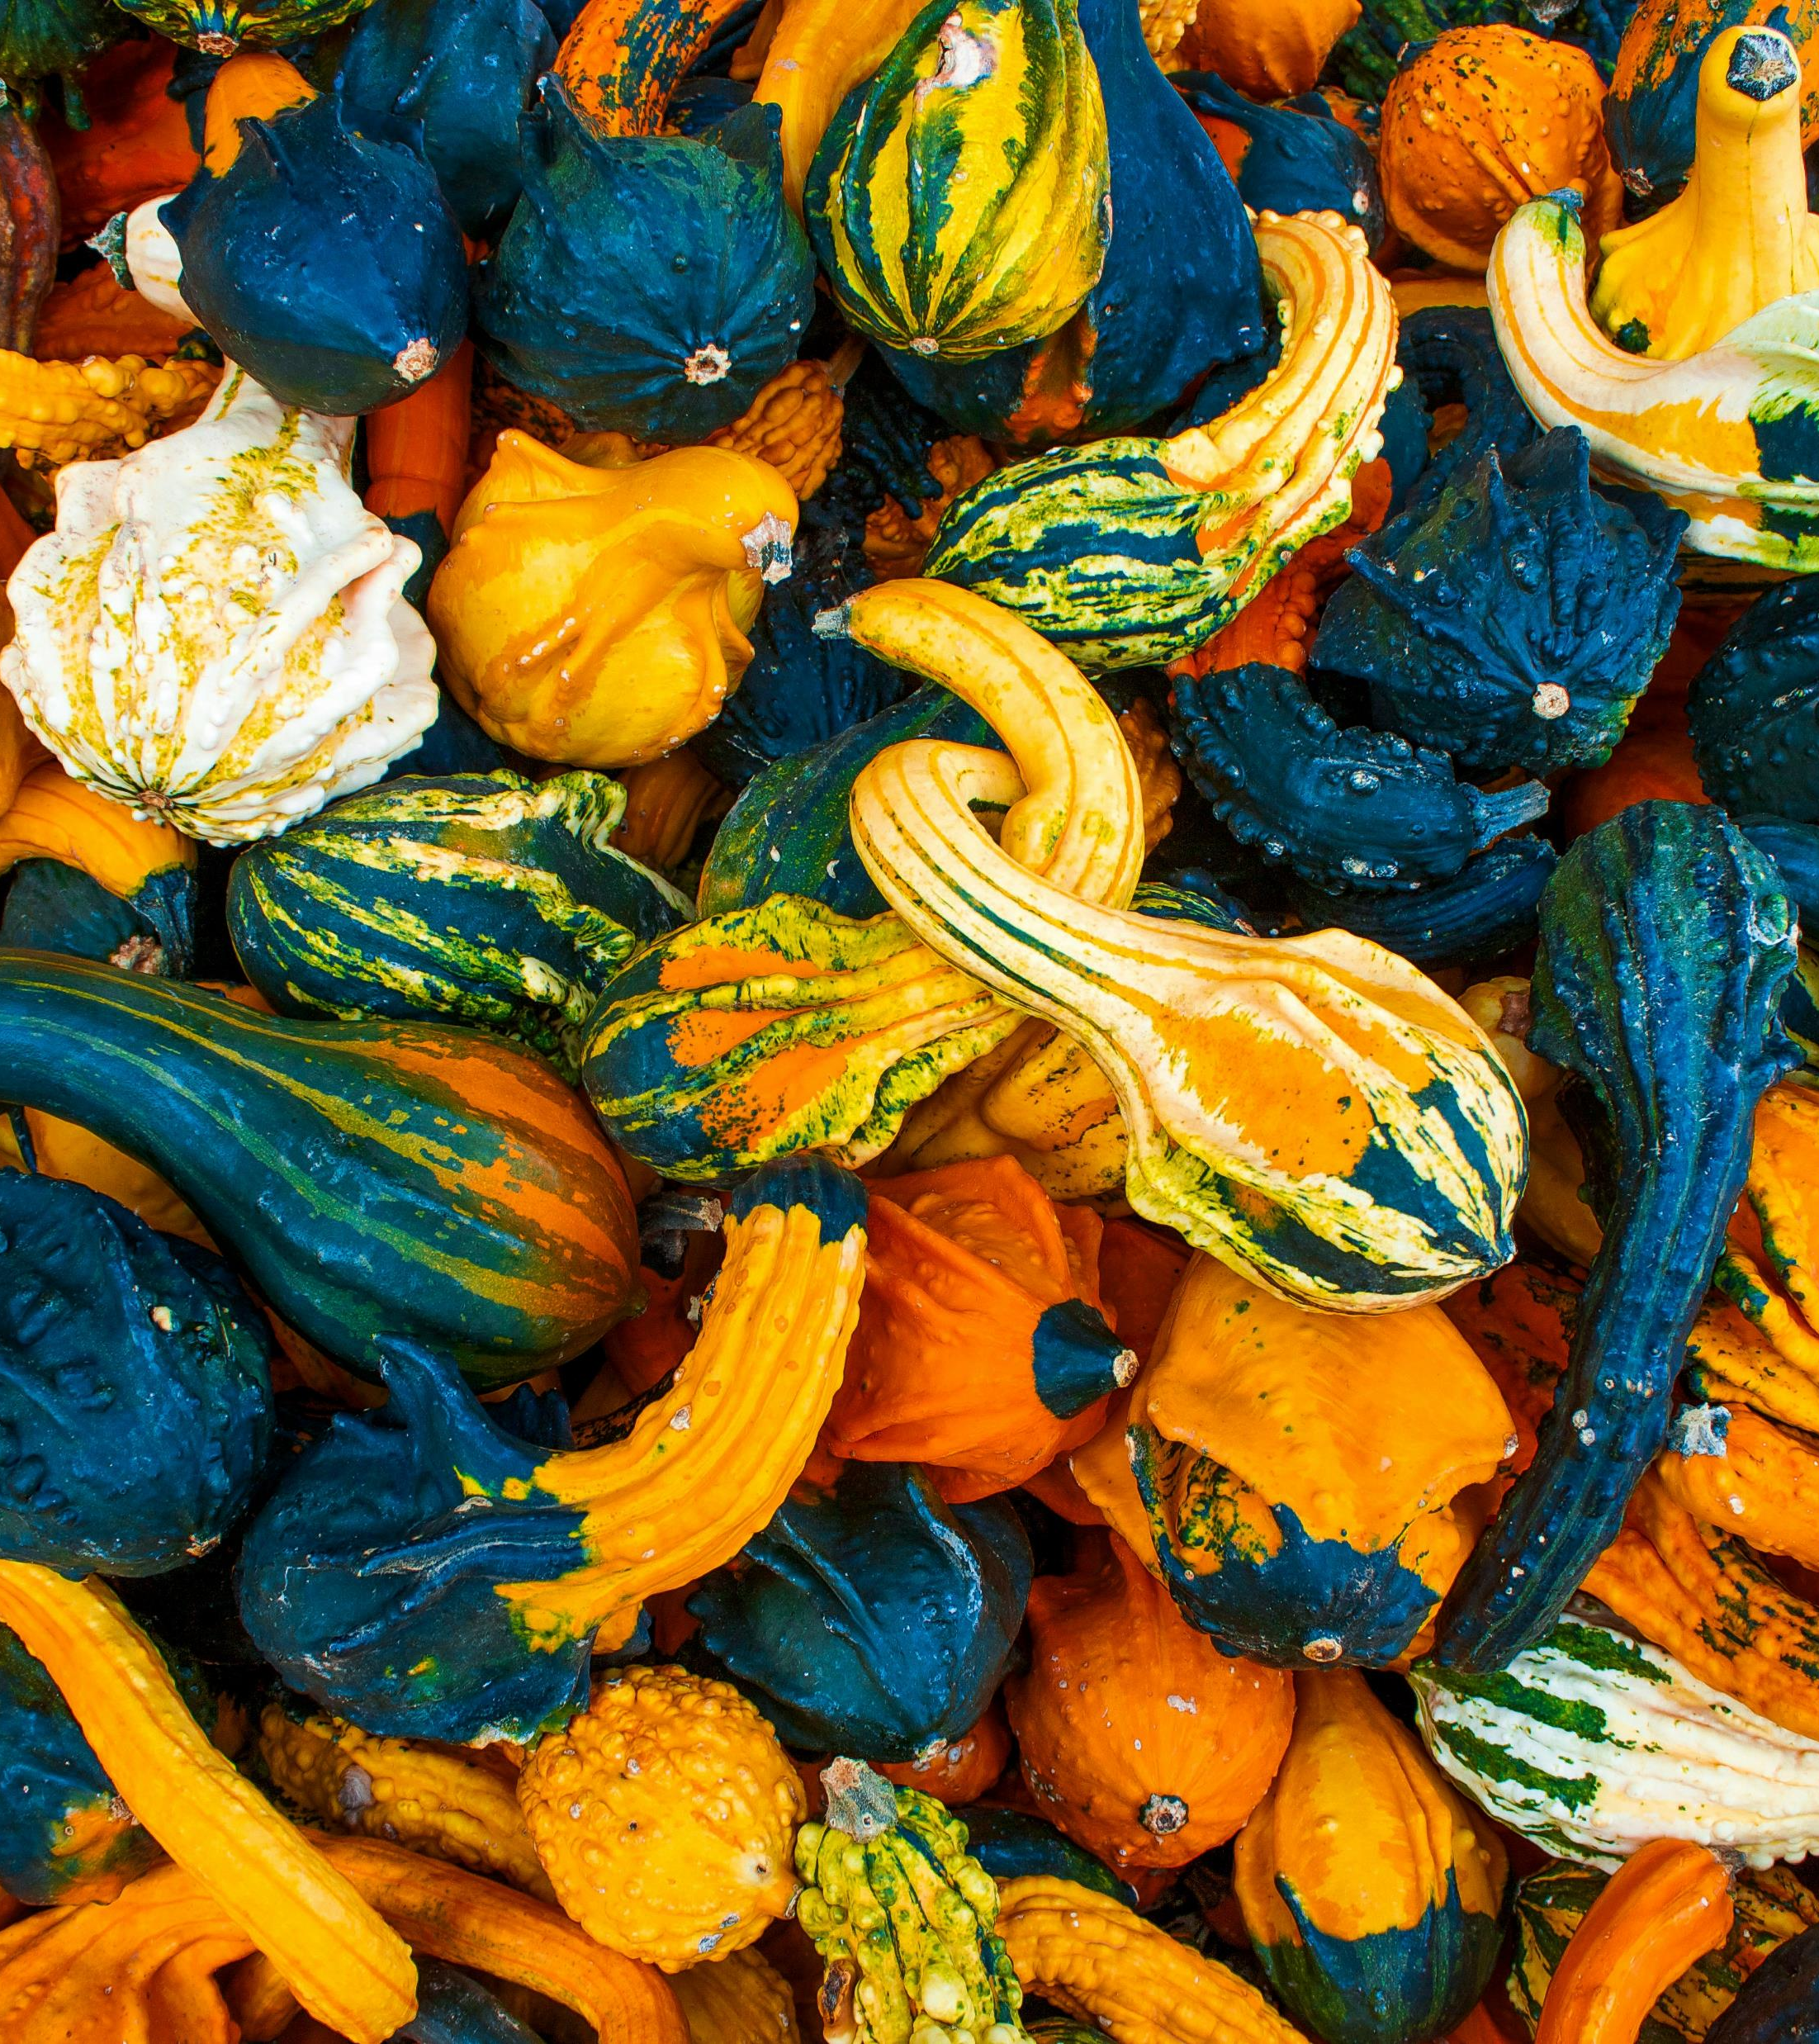
Genesis 1:29,30 And God said, “Behold, I have given you every plant yielding seed that is on the face of all the earth, and every tree with seed in its fruit. You shall have them for food… I have given every green plant for food…

Slide 6
Psalm 77:18 The crash of your thunder was in the whirlwind; your lightnings lighted up the world; the earth trembled and shook.

Slide 7
Leviticus 26:3-4
“If you walk in my statutes and observe my commandments and do them, then I will give you your rains in their season, and the land shall yield its increase, and the trees of the field shall yield their fruit.

Slide 8
Ecclesiastes 3:2
A time to be born, and a time to die; a time to plant, and a time to pluck up what is planted…

Slide 9
Pray, Reflect and Act this Creationtide.

