Slide 1
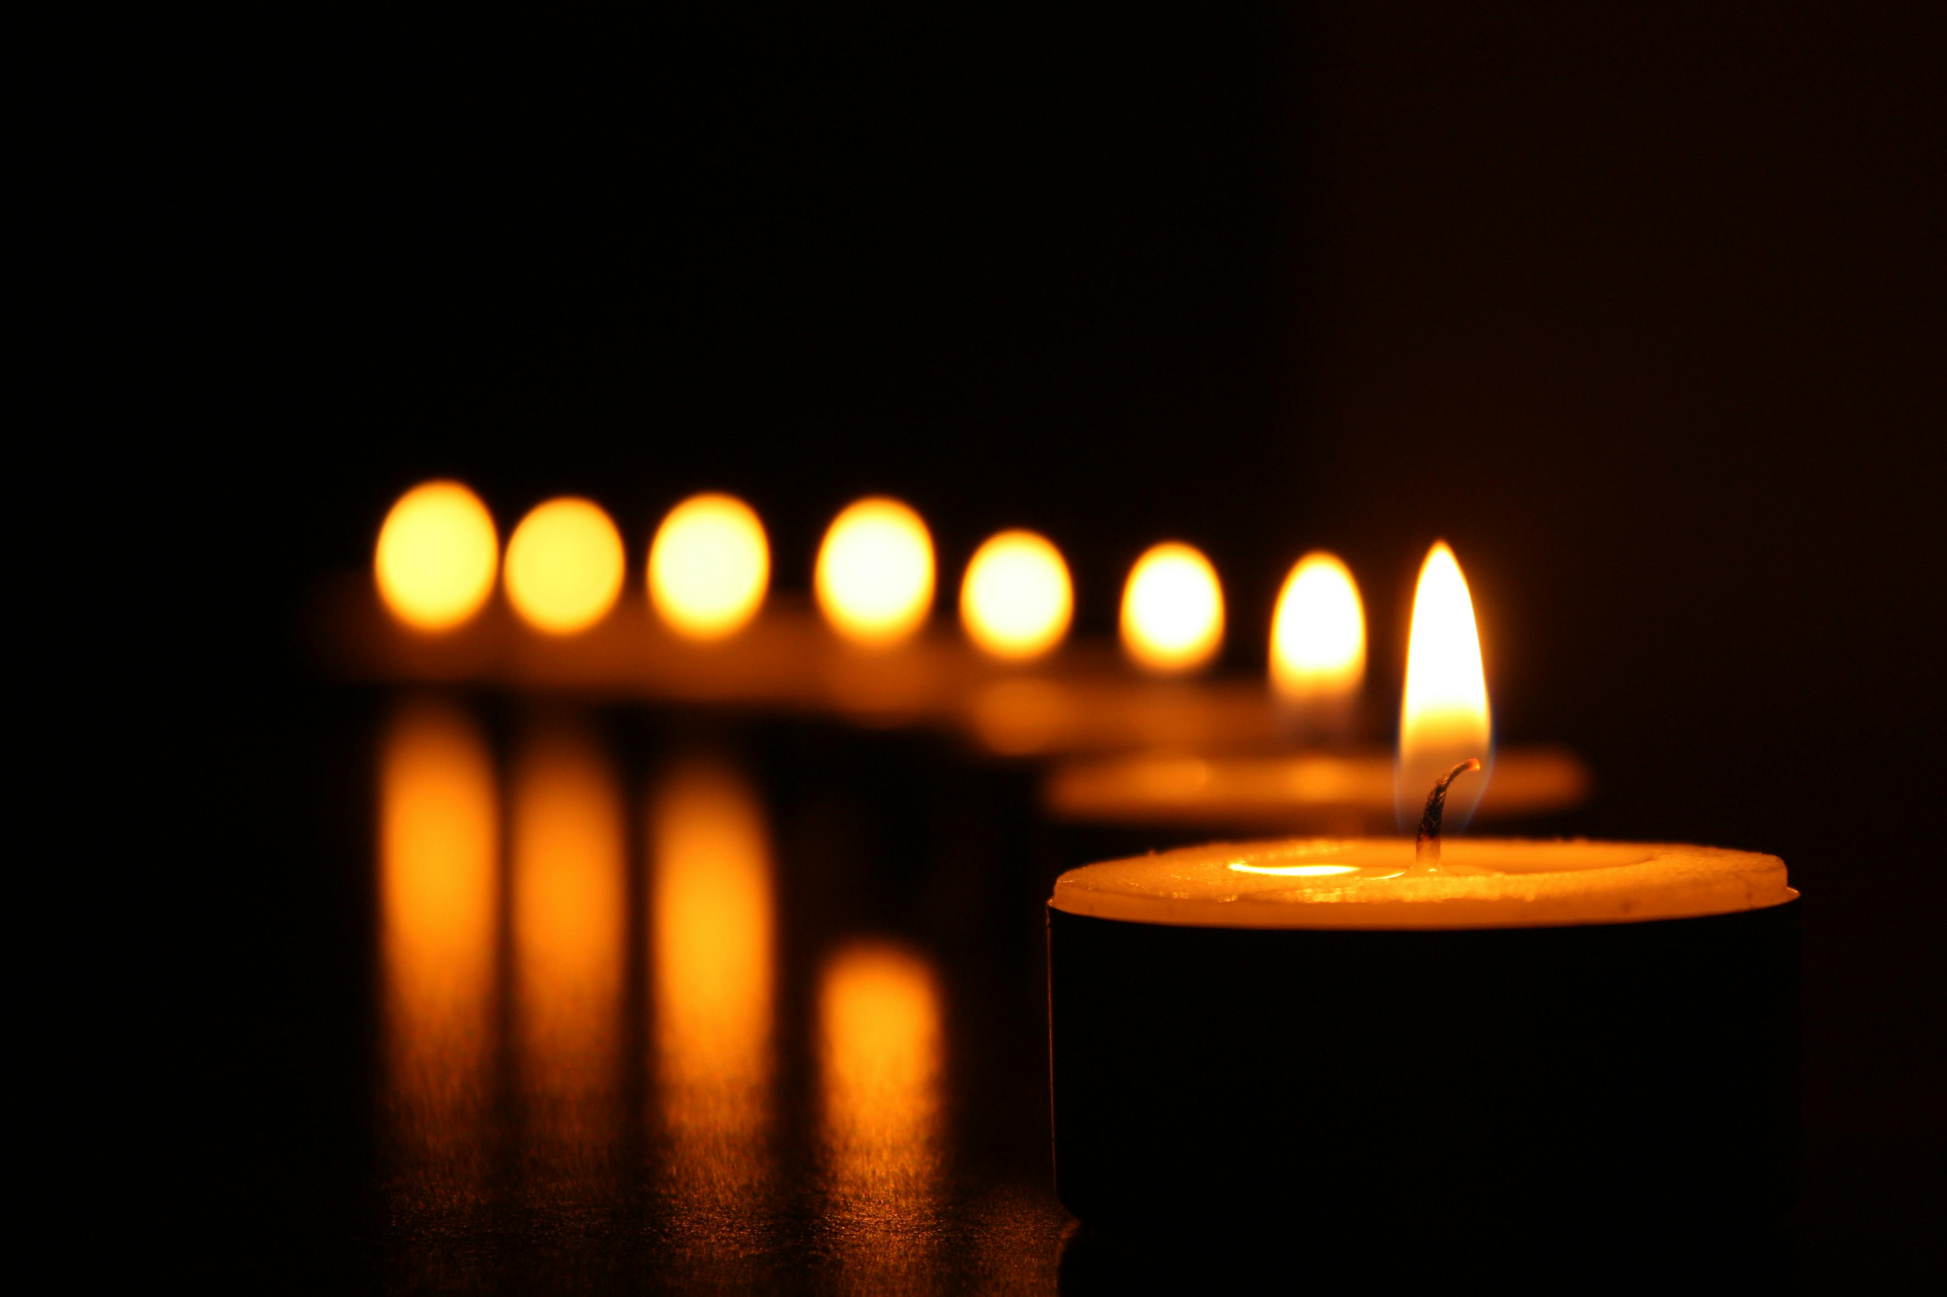
Scriptures and pictures: Praying through the hours

Slide 2
The Hours
12am - Matins 3am - Lauds 6am - Prime 9am - Terce 12pm - Sext 3pm - Nones 6pm - Vespers 9pm - Compline

Slide 3
Matins
Yours is the day, yours also the night; you have established the heavenly lights and the sun. Psalm 74:16

Slide 4
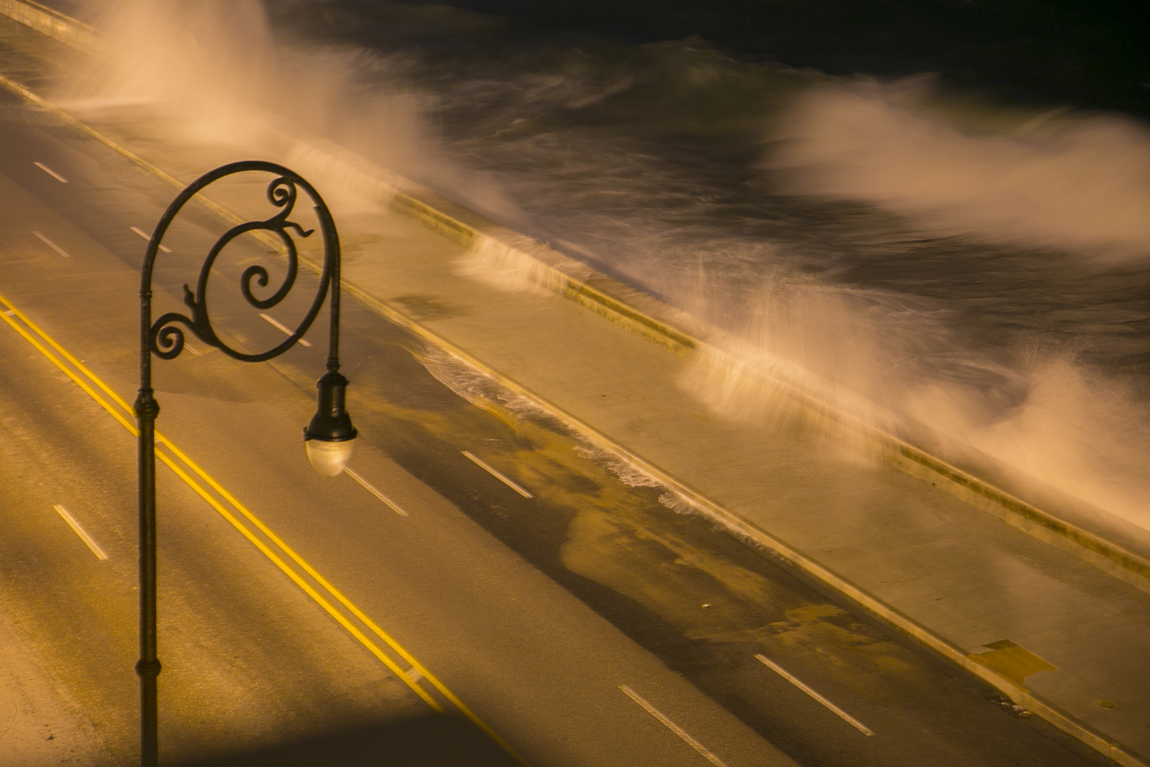
Lauds
Out of the depths I cry to you, O Lord! O Lord, hear my voice! Let your ears be attentive to the voice of my pleas for mercy! Psalm 130:1-2

Slide 5
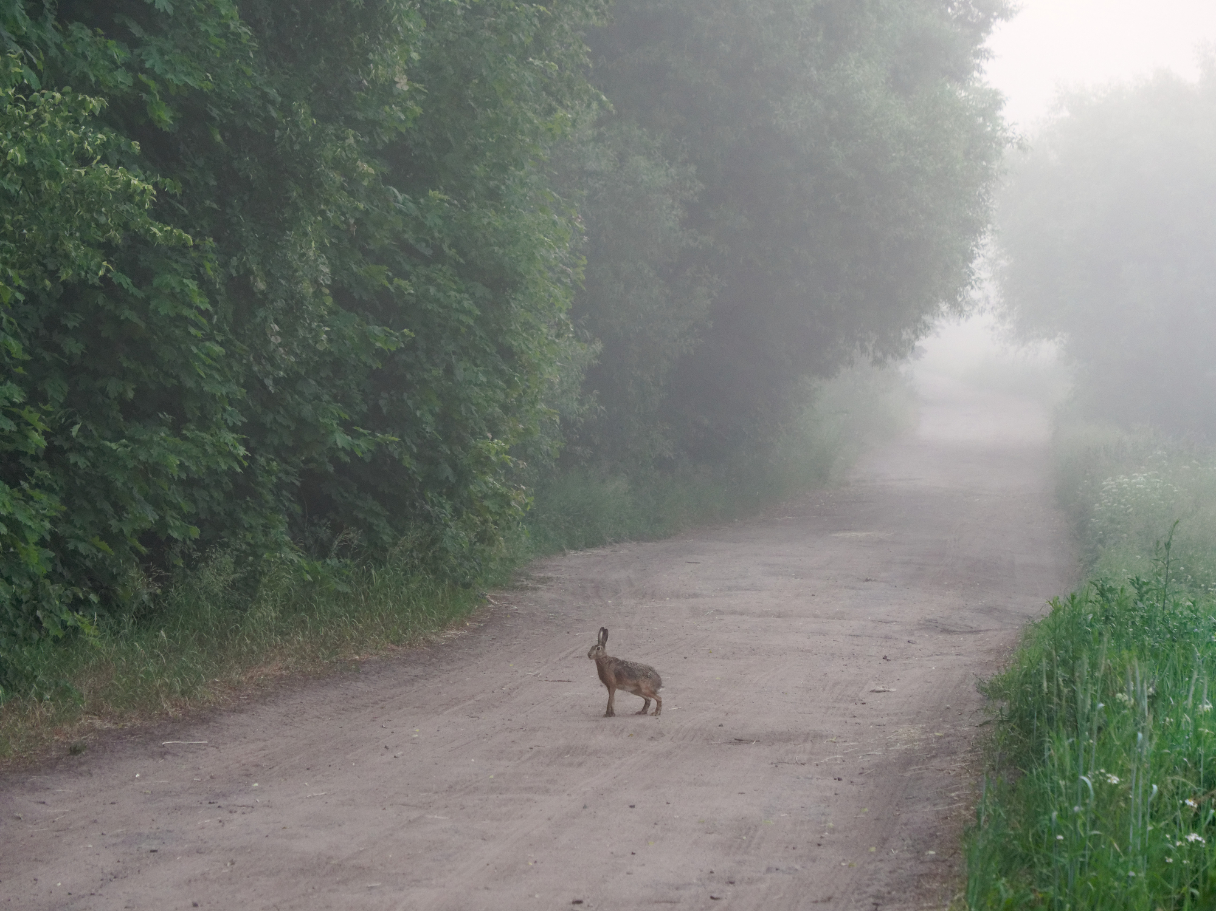
Prime
I rise before dawn and cry for help; I hope in your words. Psalm 119:147

Slide 6
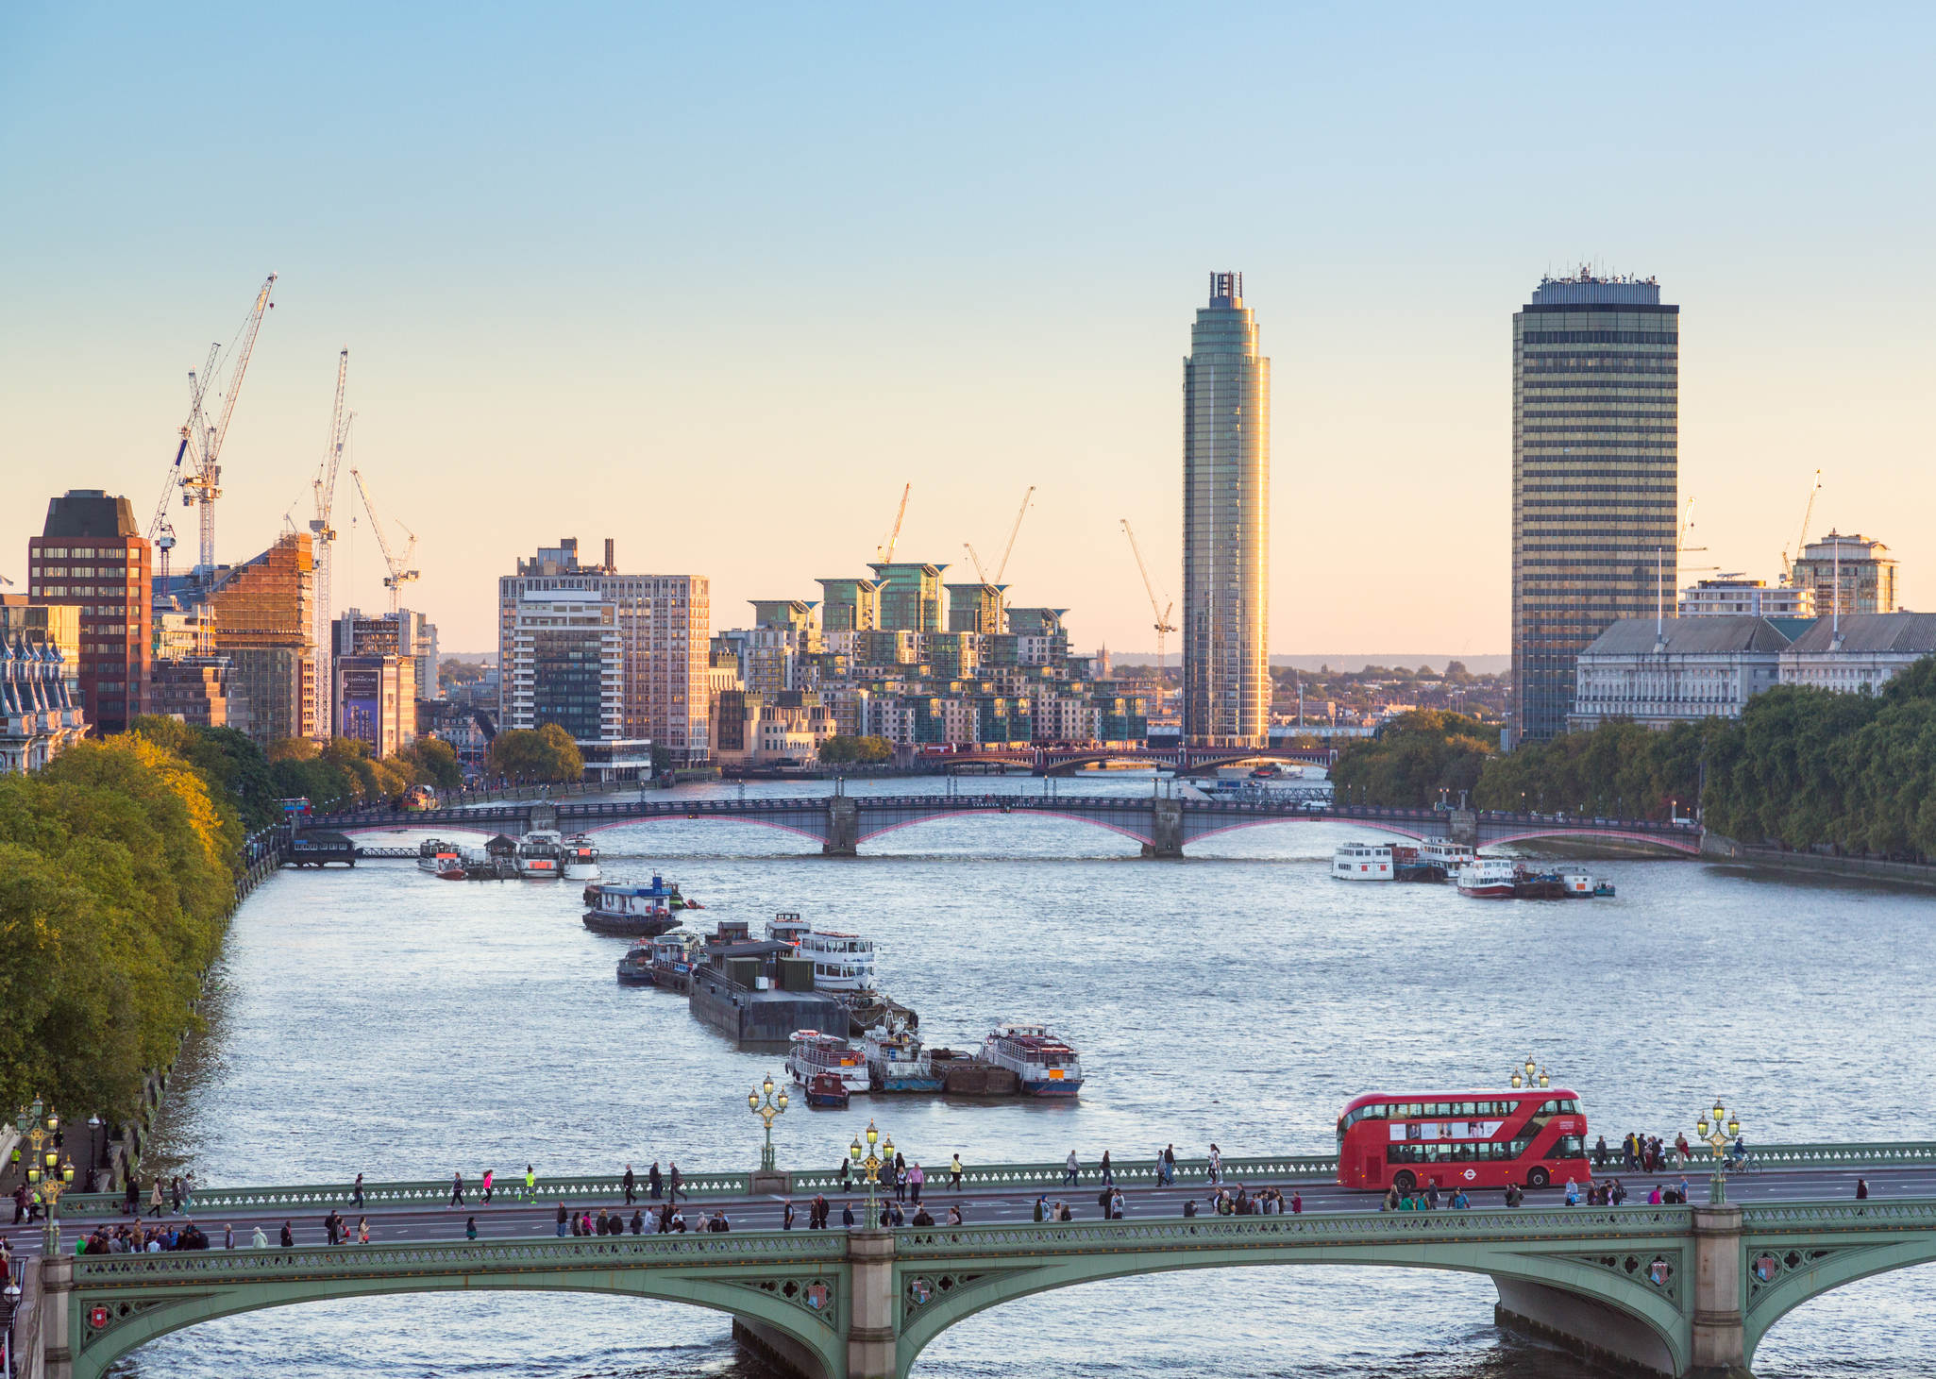
Terce People go out to their work, and to their labour until the evening. Psalm 104:23

Slide 7
Sext
My soul thirsts for God, for the living God.. Psalm 42:2

Slide 8
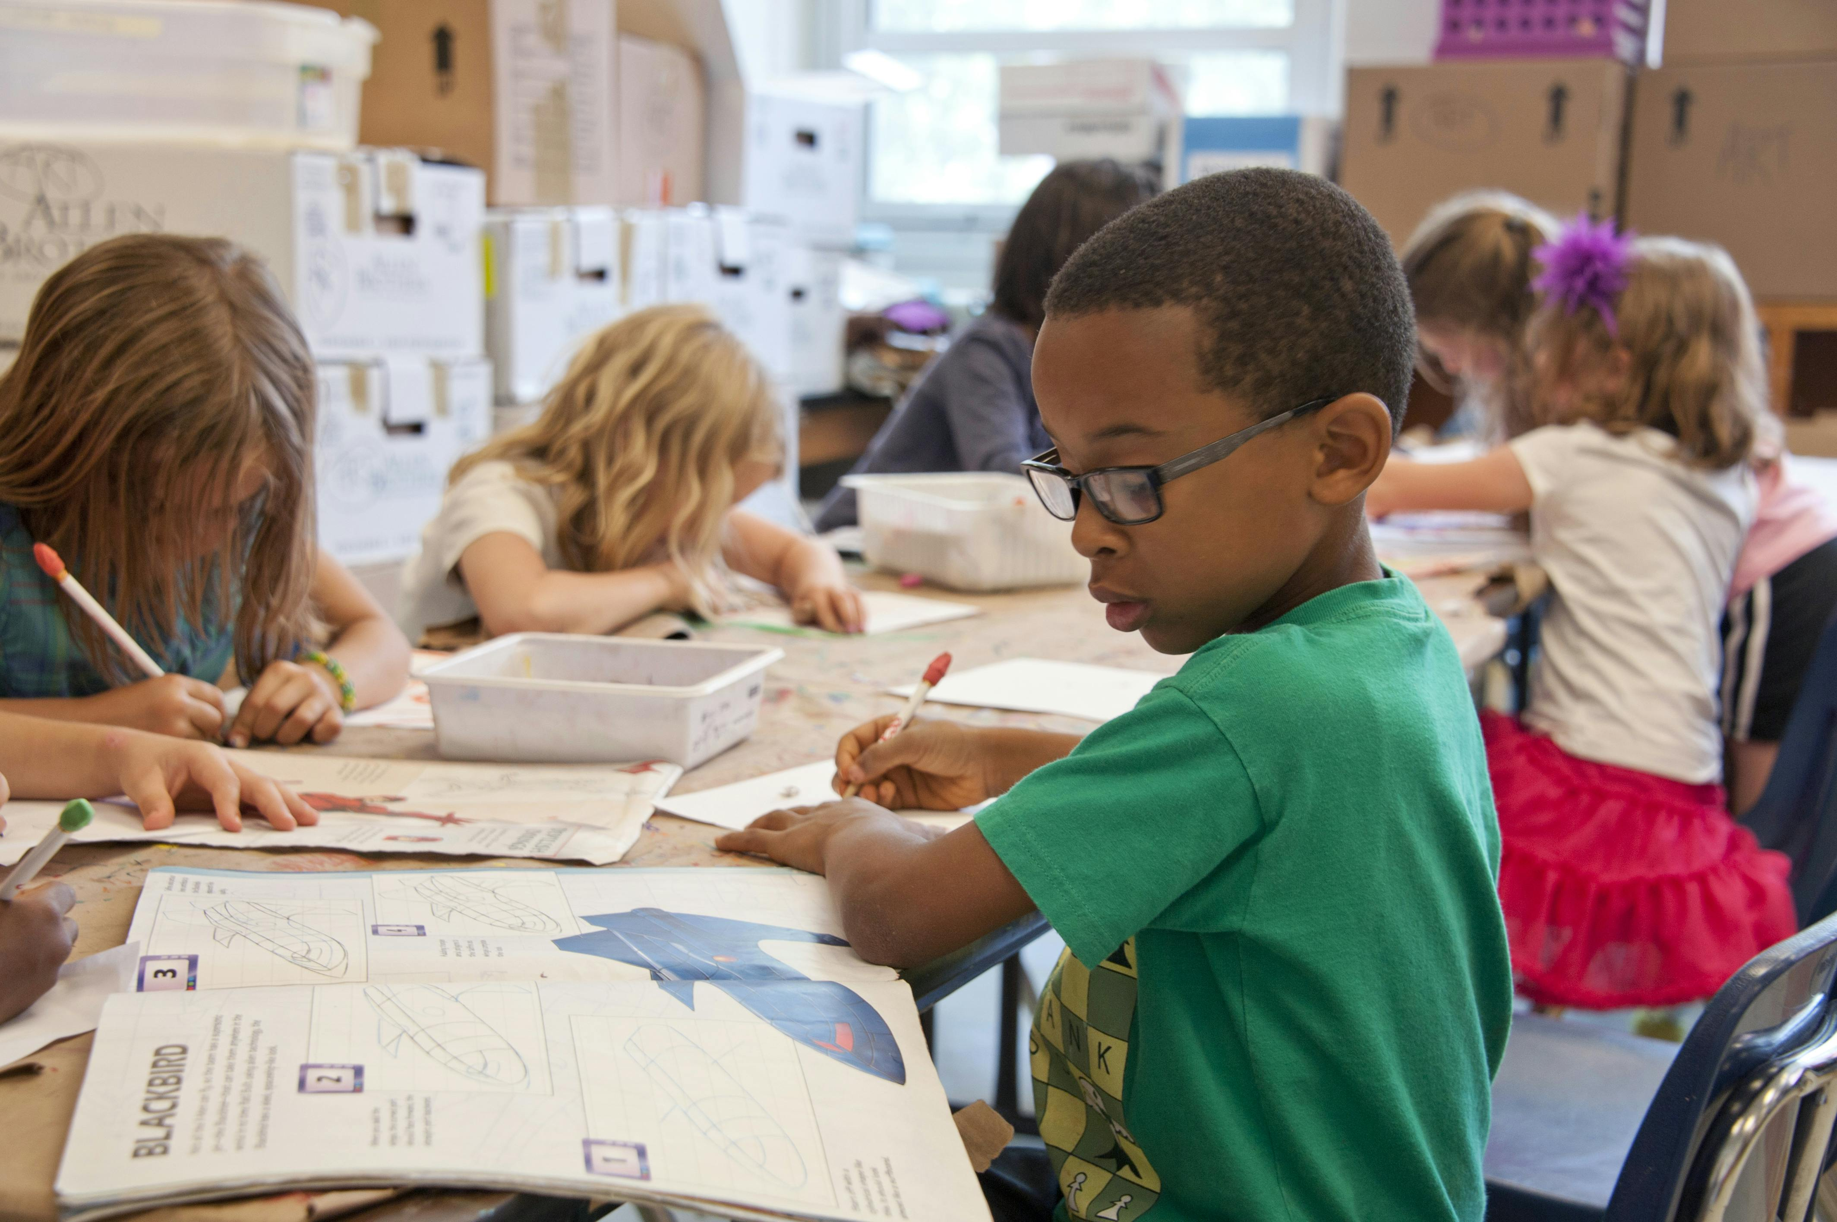
Nones Behold, children are a heritage from the Lord, the fruit of the womb a reward. Psalm 127:3

Slide 9
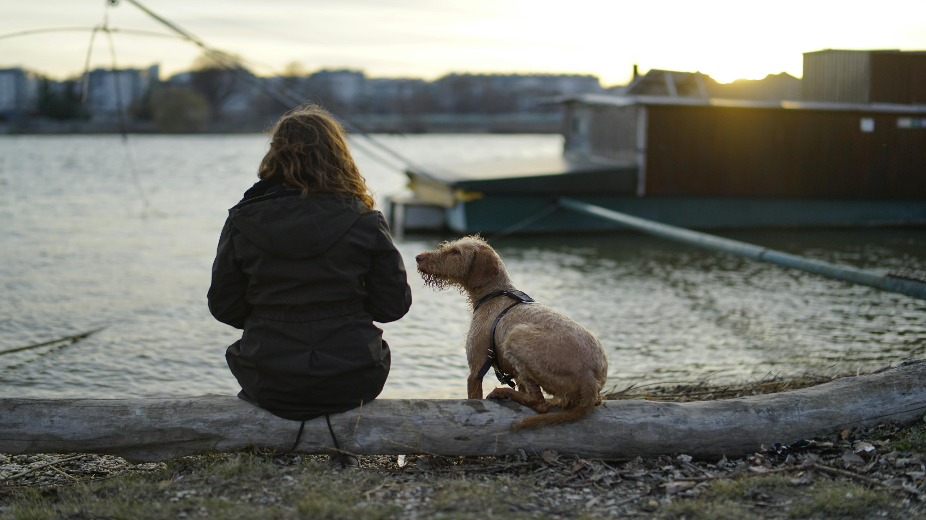
Vespers
For God alone my soul waits in silence; from him comes my salvation. Psalm 62:1

Slide 10
Compline
Your word is a lamp to my feet and a light to my path. Psalm 119:105

Slide 11
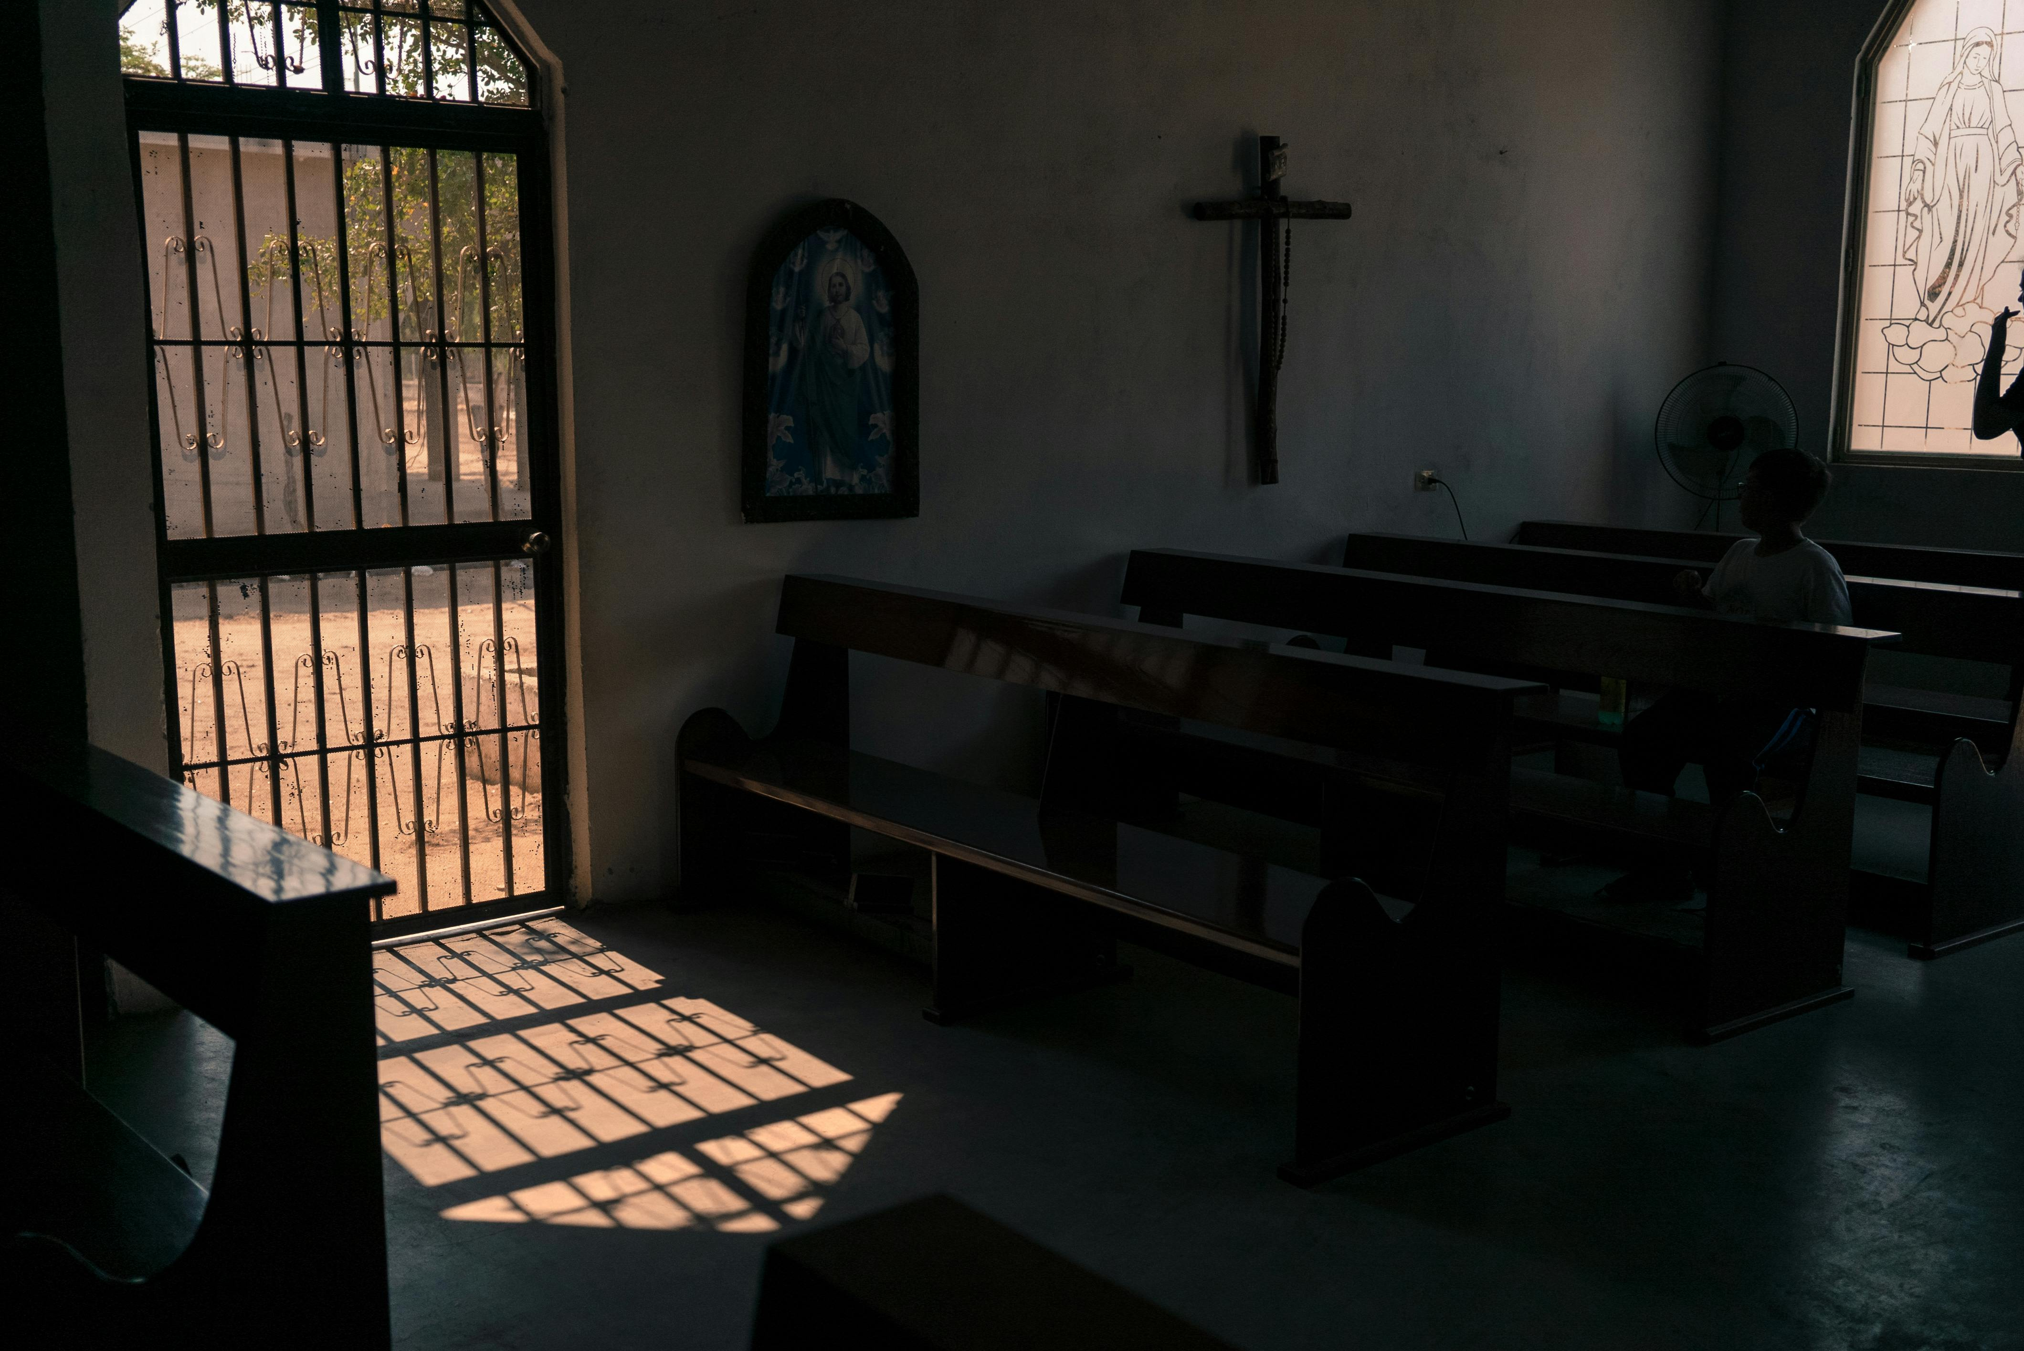
Trusting in a new day…
He restores my soul. He leads me in paths of righteousness for his name’s sake. Psalm 23:3

Slide 12
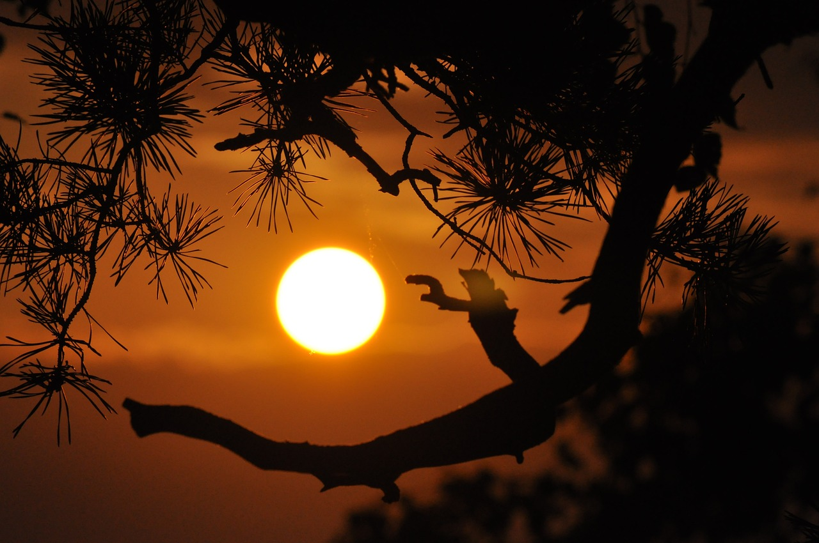
Through the day…
Blessed be the name of the Lord from this time forth and forevermore! From the rising of the sun to its setting, the name of the Lord is to be praised! Psalm 113:2-3

Slide 13
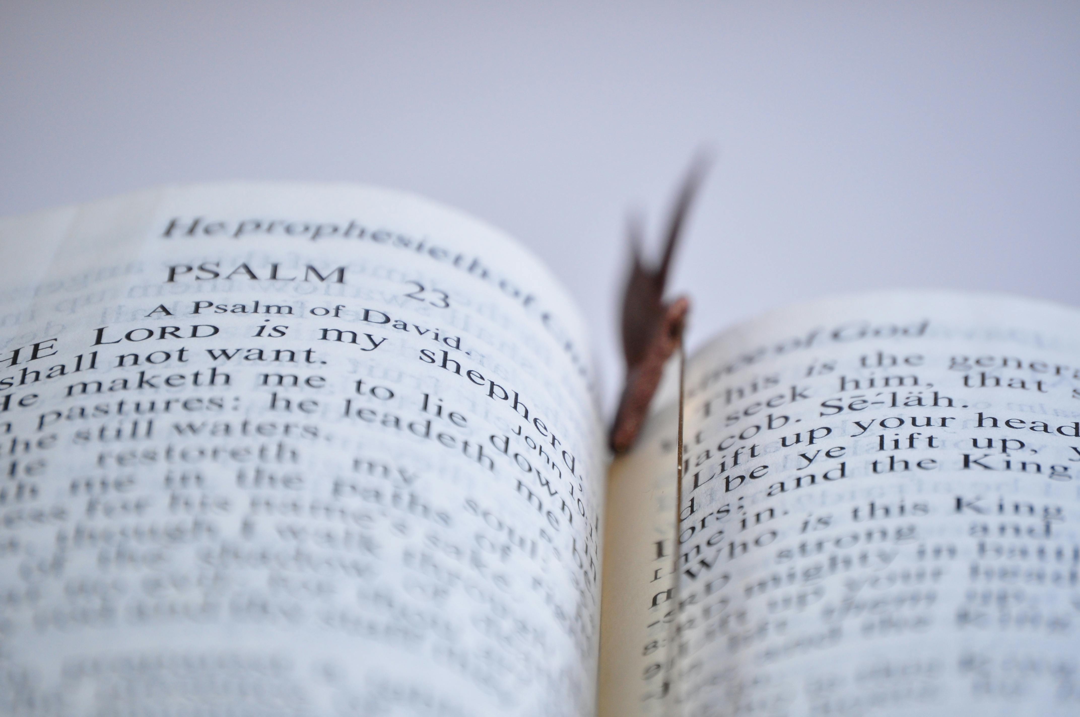
Going forwards… The Lord is my shepherd, I shall not want. Psalm 23:1

Slide 14
Scriptures and pictures: Praying through the hours
St Teresa of Avila.
Let nothing disturb you, let nothing frighten you, he who has God nothing lacks: God alone suffices.

